Slide 1



NCG602A
Methods and Techniques in Geocomputation
Lecture 15:
Living with Collinearity
Master of Science in Geocomputation

Slide 2

Outline
Collinearity in global models
Identifying and handling collinearity
GWR and collinearity
Locally compensated GWR models
Example: Dublin voter turnout
Conclusions

Slide 3
I. Collinearity in Global Models

Slide 4
Collinearity in global models
The least squares estimator yields the parameter estimates for the intercept β₀ and the variables β₁…β_{m}
β=(X^{T}X)⁻¹X^{T}y
In the estimator, X is the design matrix: the first column is usually filled with 1s, and the remaining m columns contain the values of the m independent or predictor variables
Collinearity is a characteristic of the variables in the design matrix

Slide 5
Collinearity
Collinearity exists when two or more variables in the design matrix are strongly correlated
It can also exist if a variable has a low variance – correlated with the intercept column
In a laboratory experiment collinearity can often be avoided by careful design
With social or field data we may not have this luxury – we are stuck with the problem

Slide 6
The effects of collinearity
Collinearity leads to a loss of precision and power in the parameter estimates
With over-large standard errors, potentially significant relationships will be missed
Decreased probability of rejecting H₀ when it is false
Adding or removing a variable can have a drastic impact on the parameter estimates – even changing the sign

Slide 7
II. Identifying and Handling Collinearity

Slide 8
Detecting collinearity
What measures are available which indicate the degree of collinearity in a dataset?
What levels of collinearity can we live with?
Two commonly used measures are:
  Variance Inflation Factor (VIF)
  Condition Number

Slide 9
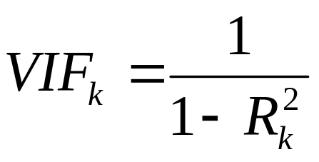
Variance Inflation Factor
The variance inflation factor (VIF) measures the degree to which the variance of an individual predictor variable is increased by the presence of collinearity with the other predictors
R²_{k} is the R² obtained by regressing the kth predictor on the other predictor variables

Slide 10
Interpreting VIFs
If you take the square root of VIF_{k}, it is the inflation factor for the standard error of the coefficient for the kth predictor
As a general rule, VIFs which are greater than 10 indicate variables which are potentially problematic
However, O’Brien (2007) cautions against the blanket use of such rules of thumb:
“Values of the VIF of 10, 20, 40, or even higher do not, by themselves, discount the results of regression analyses, call for the elimination of one or more independent variables from the analysis, suggest the use of ridge regression, or require combining of independent variable into a single index.”

Slide 11
Condition
Central to the estimation of the parameters is the cross-product matrix X^{T}X
If a matrix is ill-conditioned, then small changes in its values will lead to large changes in the solution – the outcome of the estimation becomes unstable
The condition number is a measure of the extent to which a matrix is ill-conditioned

Slide 12
Condition Number
One definition of the condition number of a matrix, κ, is the ratio of the largest to the smallest eigenvalue
If the relationship between two columns of X is almost linear, then the smallest eigenvalue will be close to zero ⇒ large κ

Slide 13
What value of κ indicates collinearity?
Belsey, Kuh and Welsch (1980) suggest that a matrix exhibits worrying levels of collinearity if its κ is greater than 30
You need fairly high correlations between all predictors to obtain a value of 30 for κ
  Correlations of ~.10 will lead to κ ~ 1.5
  Correlations of ~.90 will lead to κ ~ 20.3
  Correlations of ~.95 will lead to κ ~ 42.4

Slide 14
II.1 Empirical Example: Georgia
Educational Attainment Data

Slide 15
Georgia educational attainment data
The correlation matrix for the Georgia variables suggests a collinearity problem
PctEld PctFB PctPov PctBlack
PctEld 1.0000000 -0.4826286 0.5681833 0.2971667
PctFB -0.4826286 1.0000000 -0.3287093 -0.1120165
PctPov 0.5681833 -0.3287093 1.0000000 0.7356377
PctBlack 0.2971667 -0.1120165 0.7356377 1.0000000
The correlation between PctPov and PctBlack is 0.74
This means that it will be difficult to determine the individual contributions of each variable to the model

Slide 16
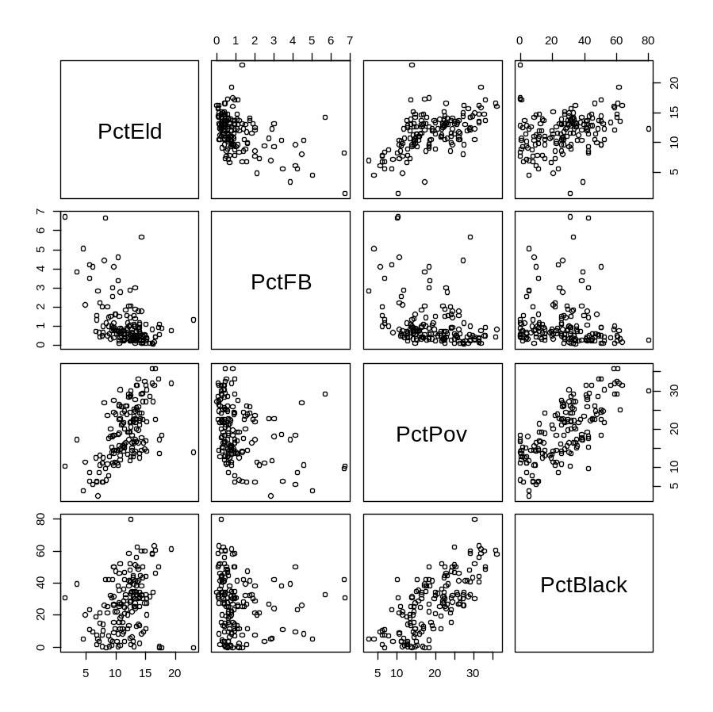
Explore!!!
The scatterplot matrix reveals that PctPov and PctBlack are related
The two variables look as through their measuring something – ethnic poverty perhaps
So, let’s fit a model …

Slide 17
The model (fitted in R)
> lm.g <- lm(PctBach~PctEld+PctFB+PctPov+PctBlack, data=x)
> summary(lm.g)
Coefficients:
Estimate Std. Error t value Pr(>|t|)
(Intercept) 12.67113 1.63682 7.741 1.22e-12 ***
PctEld -0.10531 0.13784 -0.764 0.446047
PctFB 2.54521 0.29839 8.530 1.29e-14 ***
PctPov -0.28291 0.07810 -3.622 0.000396 ***
PctBlack 0.07685 0.02803 2.742 0.006834 **
Both coefficients are significant but one is negative and one positive!
This is a typical result when using collinear data
It’s difficult to interpret what’s happening

Slide 18
Dealing with collinearity
Possible actions in the light of discovering collinearity include
  Do nothing
  Remove the offending variable(s)
  Combine the offending variables into a single index
  Transform the predictors to orthogonal principal components
  Use ridge regression
  Use the lasso (Tibshirani, 1996)

Slide 19
Ridge regression
Of the various potential solutions, perhaps the simplest is to use ridge regression
In ridge regression we add a small value, λ, to the entries in the leading diagonal of the cross-product matrix
X^{T}X + λI
So that the estimator becomes:
β = (X^{T}X + λI)⁻¹X^{T}y
λ is the ridge parameter, and I is the identity matrix

Slide 20
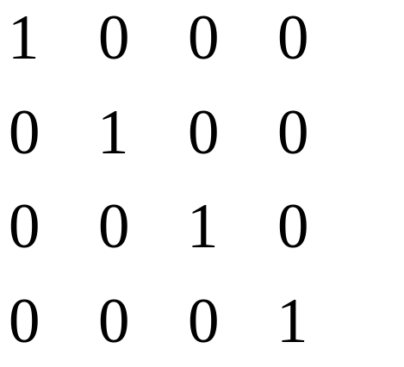
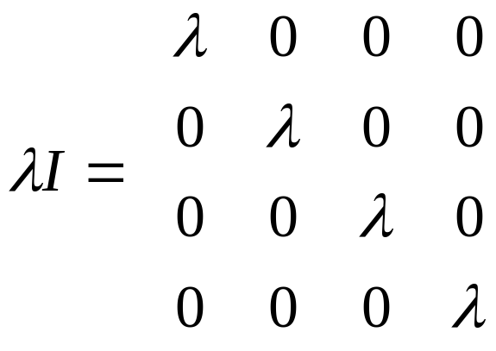
Identity matrix
This is an m x m matrix (m columns in the design matrix X).
The leading diagonal contains the value 1 in each position
The off diagonal elements are 0

Slide 21
Ridge regression
The effect of the ridge is to reduce the relative effect of data collinearity on the estimation
However, the price you pay is that the estimates of the parameters are biased – that is, the expected values are no longer the means of their parent distributions
However, this bias is generally small compared with removal of the harmful effects of collinear data
There are also no meaningful standard errors – a drawback to inference

Slide 22
III. GWR and Collinearity

Slide 23
GWR and Collinearity
The combination of spatial dependency in the data, and the geographical weighting scheme will often lead to locally raised levels of collinearity in the data
Wheeler and Tiefelsdorf (2005), and others, have raised concerns about the inferential framework for GWR in the light of local collinearity

Slide 24
All is not lost
David Wheeler has published several studies of GWR, and suggested modifications to handle collinear data
Wheeler D, 2006, Diagnostic Tools and Remedial Methods for Collinearity in Linear Regression Models with Spatially Varying Coefficients PhD dissertation, Department of Geography, The Ohio State University
Wheeler D, 2007, Diagnostic tools and a remedial method for collinearity in geographically weighted regression, Environment and Planning A 39 2464 – 2481
Wheeler D, 2009, Simultaneous coefficient penalization and model selection in geographically weighted regression: the geographically weighted lasso, Environment and Planning A 41(3) 722 – 742
Wheeler D, 2011, gwrr: Geographically weighted regression with penalties and diagnostic tools, cran.r-project.org

Slide 25
Local diagnostics
The VIFs and condition numbers appear to be generally useful tools to help us assess the levels of collinearity in our data
BUT…
Can we use them in the context of GWR?
If we use GW Ridge Regression what is the best value for the ridge parameter?

Slide 26
Local VIFs and κs
We can compute local versions of these statistics for each of the locally weighted crossproduct matrices in GWR
For the condition number the local version is merely:
κ(X^{T}W(u)X)
… where W(u) is the diagonal matrix of geographical weights relative to the location u as defined in Brunsdon et al (1996), Fotheringham et al (2002)

Slide 27
Indicators for collinear data
The local condition number gives us an indication that there is local collinearity
Likewise, local VIFs gives us some indication of which variables are locally collinear
Wheeler’s gwrr R package also uses the local variance decomposition proportion:
    Observations with a large condition index and relatively large variance-decomposition proportions for more than one regression term indicate an issue with collinearity. [Wheeler, 2011, gwrr v0.1.2 reference manual]

Slide 28
Strategies
We can map the local VIFs and local condition numbers
These highlight any areas for which the estimates of the parameters may be suspect
We could also map the local correlations between the predictor variables

Slide 29
BUT
© S Openshaw, 1980s onwards

Slide 30
With, 8 predictor variables, we get 28 maps of local correlations …
… and we start to drown in diagnostic detail

Slide 31
Complexity
Local condition numbers
  n per data set
Local VIFs
  n x p per data set
Local correlations
  n x (p(p-1)/2) per data set

Slide 32
Actions
Interpret the results with caution
Remove the variables – however, this may be detrimental to our model performance elsewhere in the study area
Transform the data, but there’s no guarantee that a global principal components transform might not have local dependencies
Develop models which locally adapt to spatial variations in the collinearity structure to mitigate the worst effects of collinearity in the affected areas

Slide 33
IV. Locally Compensated GW Ridge Regression

Slide 34
GW Ridge Regression
Wheeler (2007) suggests GW Ridge regression as an approach
A geographical weighting scheme can be created for ridge regression so we can estimate local values for the parameters:
β(u) = (X^{T}W(u)X + λI)⁻¹X^{T}W(u)y
The ridge then becomes a global parameter, as with the bandwidth

Slide 35
What value for the ridge parameter?
It can be supplied exogenously by the user
It can be estimated, along with the bandwidth, to give the best fit
If we estimate, we need a function which can find the values of both two parameters (h and λ) that either minimise a cross-validation score or the AICc
Wheeler found that the estimation is more sensitive to variation in the bandwidth rather than the ridge

Slide 36
Global/local ridges
We observe that the level of collinearity varies within the study area
We want the ridge value that yields the best predictions yet minimises the effects of collinearity
However, in areas where collinearity is not a problem, we don’t need to add a ridge
In areas where collinearity is a problem, then we should add a ridge… but what value?

Slide 37
Ridge and the CN
The ridge value λ and the CN, κ, are linked..
Recall that the CN is the ratio of the largest to the smallest singular values (e₁/e_{m})
It can be shown that
λ = (e₁ – e_{m})/(κ – 1) – e_{m}
… so if we want to limit the CN to some maximum (say 25) we can compute the value of the ridge, λ, that is required.

Slide 38
Effect of the ridge
The effect of the ridge is to reduce the variance of the estimates by shrinking them towards zero
This introduces bias, but reduces the effects of any multicollinearity in the data
The question arises as to the best value of the ridge parameter…
… and whether the ridge parameter could vary locally

Slide 39
Locally compensating ridges
We can turn the problem on its head and specify a maximum level of local collinearity that we are willing to live with
  Belsey, Kuh and Welsch (1980, p116) note that “collinearity doesn’t hurt so long as it doesn’t bite”.
If we are willing to live with collinear data that yield local crossproducts matrices whose κ is not greater than κ_{max}, then we can use the previous result to modify κ locally only when needed

Slide 40
Caution
However, this is not a panacea for all ills, and any modelling should thoroughly investigate local collinearity issues before a final model is adopted.
We still need to map the local VIFs and κs before a ridge or bandwidth modification
We can then map the local ridge parameters – very high values may indicate remaining local problems

Slide 41
Does LCR work?
We undertook a simulation experiment to compare the accuracy of the coefficient estimates among four models:
  Global Multiple Linear Regression
  Basic Geographically Weighted Regression
  Locally Compensated Ridge-GWR
  Locally Compensated Bandwidth-GWR

Slide 42
Example results
The simulations had the following characteristics:
Sample size 289 (13 x 13 grid)
Three levels of collinearity in the predictor variables
High collinearity in the true coefficients
High smoothness in the true coefficients
Relatively small error term (with respect to mean process)
25 simulations

Slide 43
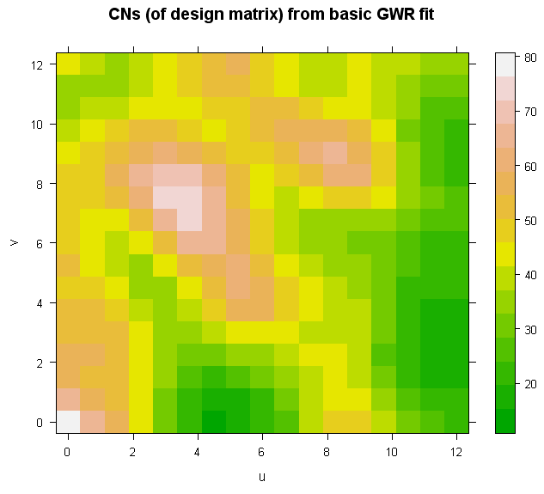
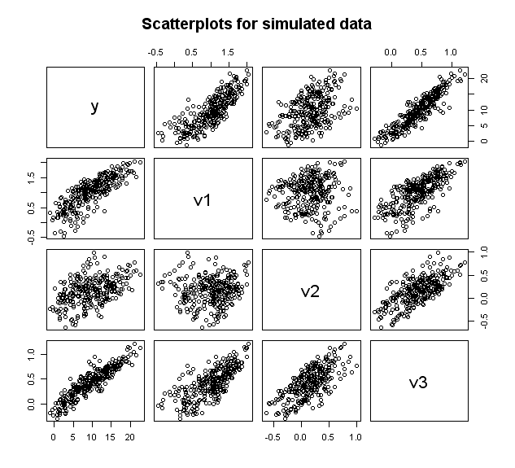
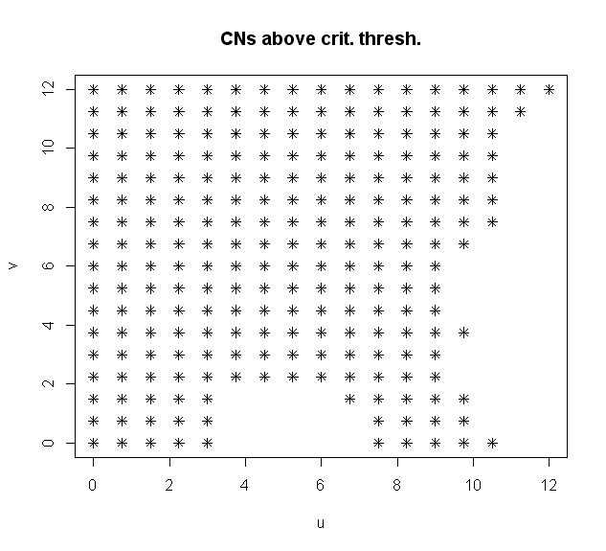
Example simulation: scatterplots and diagnostics

Slide 44
Simulation results
A measure of the coefficient accuracy is the Relative RMSE (smaller is better)
Predictor variable collinearity | Global | GWR | LCR-GWR | LCB-GWR
Weak | 1.670 | 1.316 | 1.376 | 1.509
Moderate | 2.197 | 1.880 | 1.594 | 2.124
Strong | 2.264 | 2.486 | 1.676 | 2.262
When the collinearity is low there is little choose between the GWR and LCR
As the collinearity increases the LCR-GWR is the model which best fits the data

Slide 45
V. LCGWRR Example

Slide 46
Dublin voter turnout
Predictors of turnout for the 2004 Irish General Election
8 variables suggested by the literature
But initial analysis suggests that collinearity is present
We’ll use functions from the recently developed GWmodel R package

Slide 47
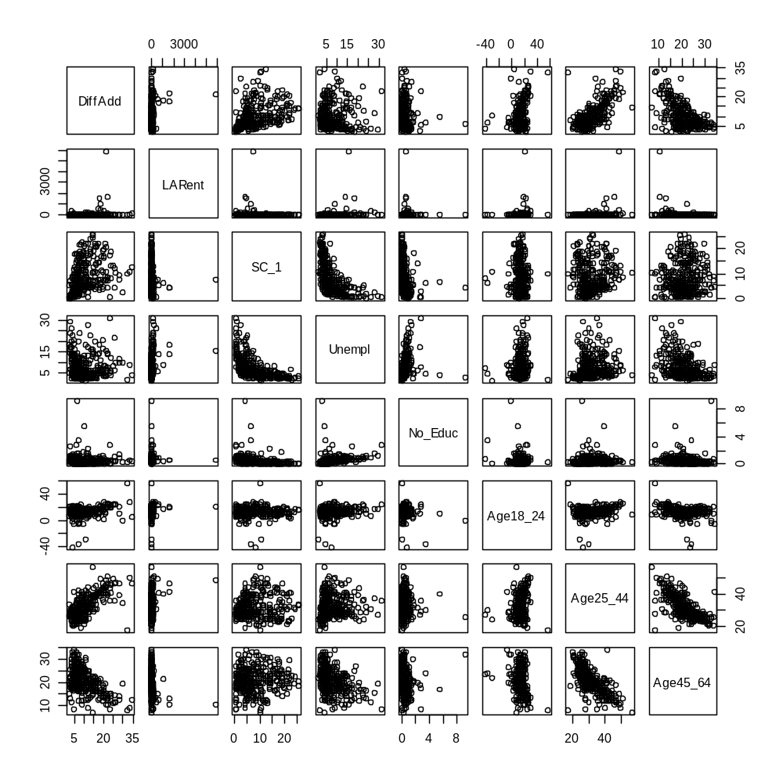
Dublin Voting
Data
A scatterplot matrix reveals potentially globally collinear variables.

Slide 48
Loadings:
Comp.1 Comp.2 Comp.3 Comp.4 Comp.5 Comp.6 Comp.7 Comp.8
DiffAdd -0.504 -0.285 0.119 -0.154 0.225 0.448 0.608
LARent -0.241 -0.205 0.933 -0.112
SC_1 -0.636 0.160 -0.223 0.536 -0.266 -0.391
Unempl -0.223 0.575 -0.131 0.143 0.694 0.180 -0.251
No_Educ 0.393 0.573 -0.705 -0.101
Age18_24 -0.267 -0.710 -0.293 -0.534 -0.152 -0.157
Age25_44 -0.532 -0.101 0.242 0.203 -0.385 0.331 -0.590
Age45_64 0.531 0.153 -0.265 0.753 -0.198
> pca1$sdev^2/sum(pca1$sdev^2)
Comp.1 Comp.2 Comp.3 Comp.4 Comp.5 Comp.6 Comp.7 Comp.8
0.32487 0.23807 0.12775 0.11151 0.09051 0.04741 0.03607 0.02377
.33 .56 .69 .80 .89 .94 .98 1.00
70% of variance is accounted for by the first three components: suggests global collinearity amongst the variables = problems! Global Condition Number is 40.

Slide 49
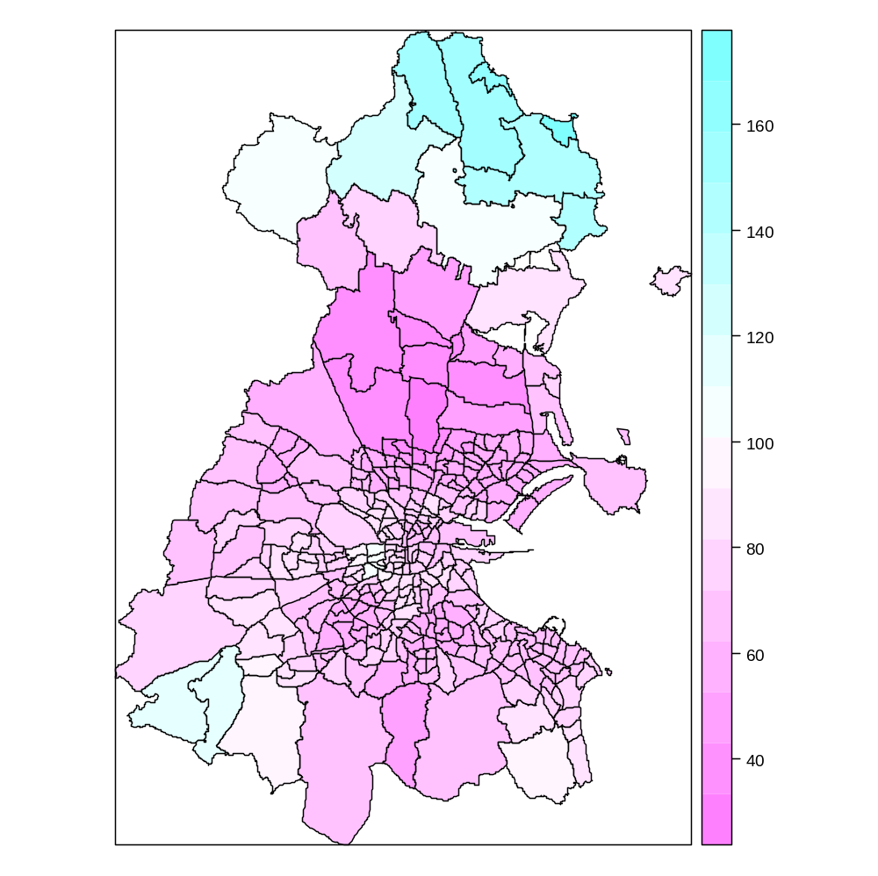
First... Local condition numbers
Local multicollinearity is a major problem with these data
  Adaptive kernel bandwidth = 65
Notice how the local kernels magnify the local CNs: range 40 ... 180 global CN is about 40

Slide 50
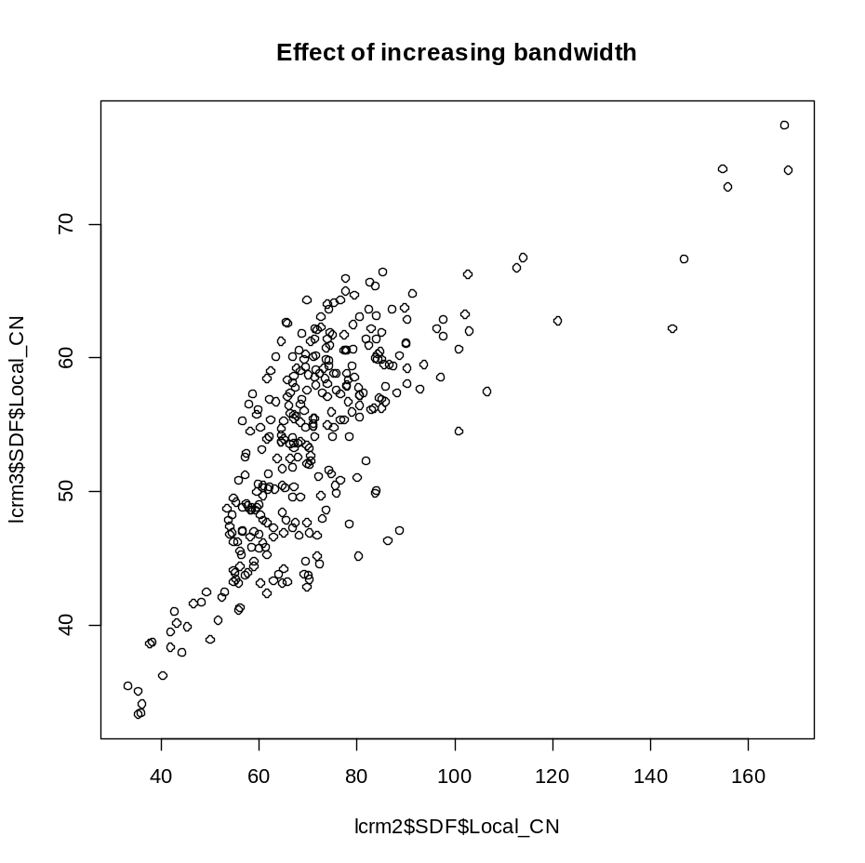
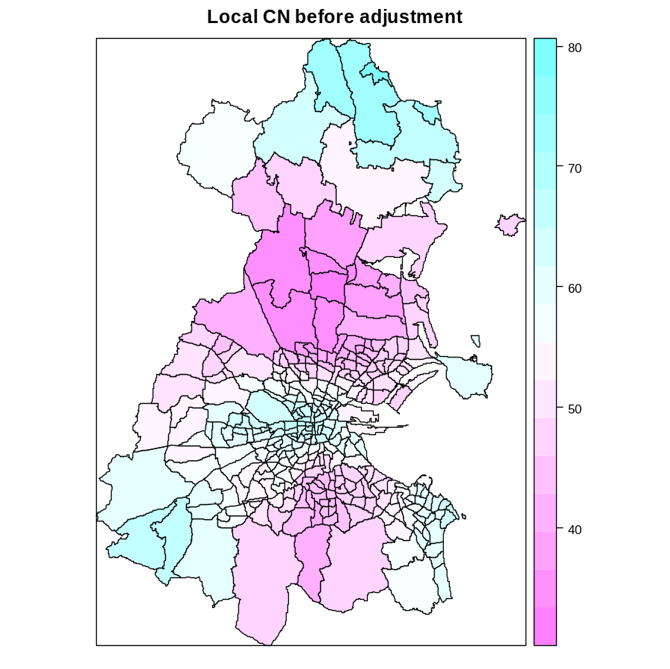
Just Increasing the bandwidth lowers the local CNs: range is reduced from 40:180 to 30:80.
However, we’ll now apply local adjustment to keep them below 30.

Slide 51
Apply local compensation
> lcrm3.bw <- bw.gwrlcr(GenEl2004~DiffAdd+LARent
+SC_1+Unempl+No_Educ+Age18_24+Age25_44+
Age45_64, data=Dub.voter, kernel="bisquare",
adaptive=TRUE,
lamda.adjust=TRUE, cn.thresh=30)
> lcrm3.bw
[1] 141 Note the larger bandwidth!
lcrm3 <- gwr.lcr(GenEl2004~DiffAdd+LARent+
SC_1+Unempl+No_Educ+Age18_24+Age25_44+
Age45_64, data=Dub.voter, bw=lcrm3.bw,
kernel="bisquare", adaptive=TRUE,
lamda.adjust=TRUE, cn.thresh=30)
We’ll cap the local κs at 30 by adjusting the local λs.

Slide 52
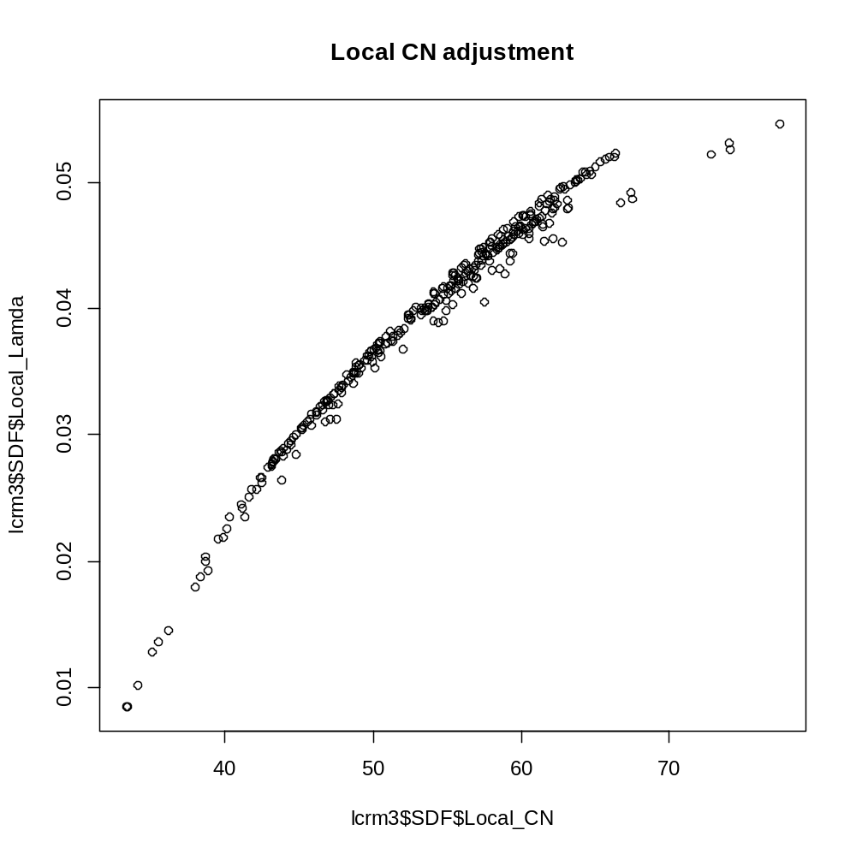
The plot of the locally adjusted λ against the the unadjusted local κ shows that larger values of κ are subject to greater adjustment.

Slide 53
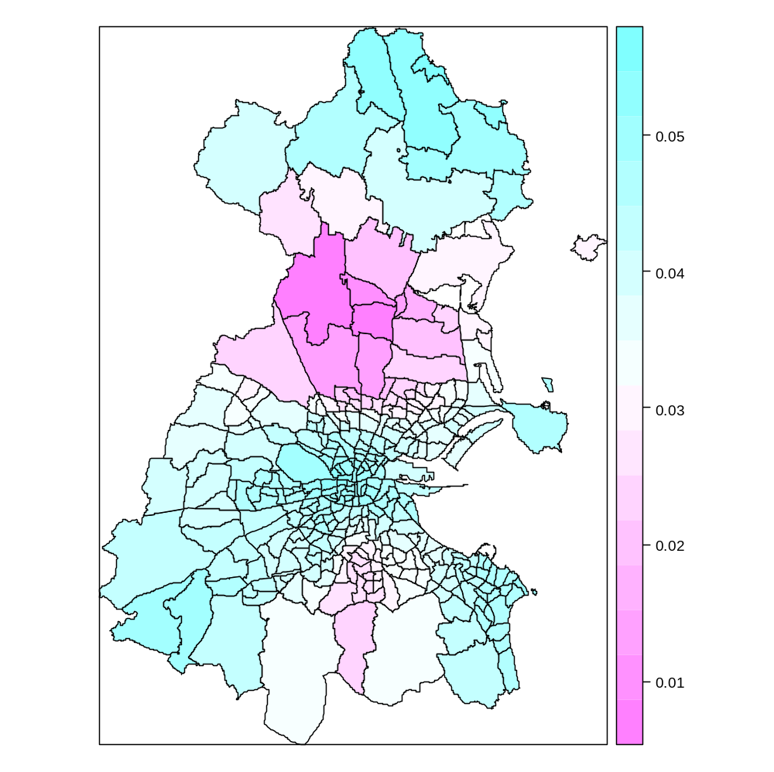
Locally adjusted ridge parameters (λ)
The locally adjusted ridge parameters are greatest in the north, south east and south west parts of the study area
We should certainly take care when making any local inferences

Slide 54
VI. Conclusion

Slide 55
Conclusions
GWR is an important exploratory tool when non-stationary relationships are suspected.
The advantage is that geographically weighted exploration suggests where collinearity will be a local issue
If the data is relatively collinearity free – use GWR
If there are some local problems – proceed with caution with a locally compensated model
If global collinearity is a problem then take appropriate action - GIGO

Slide 56
Explore, explore, explore
This means that you need to be aware of the characteristics of your data long before you start creating any GWR models
Early data exploration is paramount, and without it, you will run into problems
  Problems estimating the model
  Problems interpreting the results

Slide 57
Finally
Collinearity is an issue that we will have to live with
It affects global models as well as local models
Local models have the benefit that they inform where collinearity is a problem
Collinearity should not be ignored

Slide 58
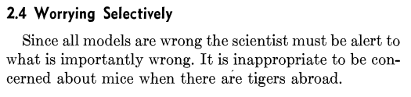
GEP Box, 1976

